Slide 1


To What Extant Does Land Use Impact on E-food Desert Index in London?
Group 3
Youtian Peng Yijing(Rose) Zhang
Zhang Qin Huayue(Rayne) Cheng

Slide 2

Introduction
Data Selection
Descriptive Statistical Analysis
Modelling Analysis
Discussion

Slide 3
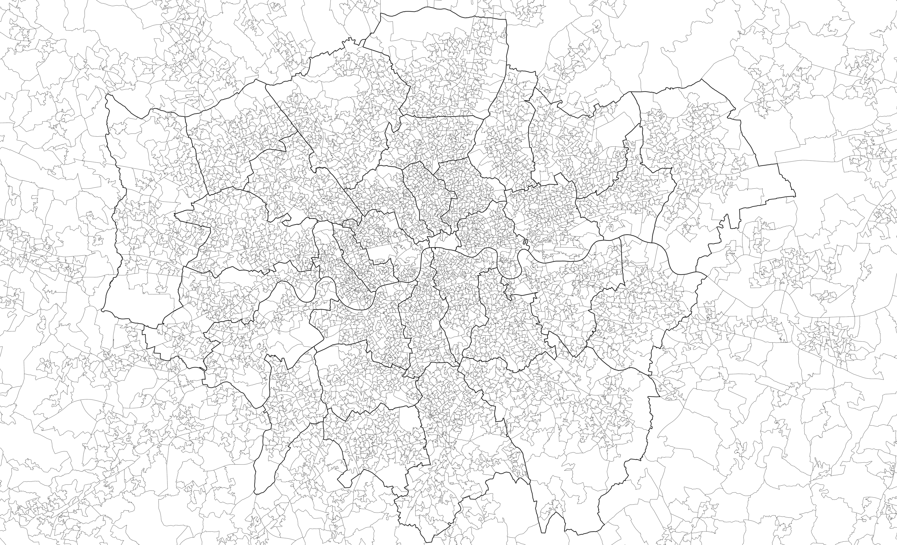
1. Data Selection
Background
Independent & Dependent Variables
Data Source
To What Extant Does Land Use Impact on E-food Desert Index in London?

Slide 4
Background
Food deserts (late 1990s and early 2000s)
neighbourhoods which had been ‘abandoned’ by the major retailers, resulting in poor access to larger format grocery stores providing fresh, healthy and affordable food. Many of these neighbourhoods were some of the most deprived in England and Wales and were located within inner city areas where residents faced considerable financial and practical (e.g. access to transport) barriers to accessing food store provision.
E-food desert (2020)
remote and rural catchments with poor ‘access’ to groceries home delivery services. These catchments are already the most remote from physical store provision and may also be faced with withdrawal of physical (retail) services. The e-Food Deserts Index (EFDI) was developed to re-assess the presence of food deserts across Great Britain, accounting for novel notions of groceries home delivery provision.
Andy Newing, et al. (2020) EFDI User Guide. Consumer Data Research Centre. Available at: https://data.cdrc.ac.uk/sites/default/files/efdi_userguide.pdf
Newing, A., Hood, N., Videira, F.& Aewis, J. (2022) ‘Sorry we do not deliver to your area’: geographical inequalities in online groceries provision, The International Review of Retail, Distribution and Consumer Research, 32:1, 80-99, DOI: 10.1080/09593969.2021.2017321

Slide 5
Background
The e-food desert index (EFDI) is a multi-dimensional composite index for GB which measures the extent to which neighbourhoods exhibit characteristics associated with food deserts across four key drivers of groceries accessibility:
Proximity and density of grocery retail facilities
Transport and accessibility
Neighbourhood socio-economic and demographic characteristics
E-commerce availability and propensity
Source: CDRC
Notes:
In addition to urban deprivation, it highlights a new driver of inequalities in access to groceries, termed ‘e-food deserts’ – remote and rural neighbourhoods which suffer the dual disadvantage of comparatively poor access to physical retail opportunities alongside limited provision of online groceries.

Slide 6
Basic description of land use data
The significant feature of developed land use in London
Proportion of land that is of developed use
England 2022
Source: CDRC

Slide 7
Land use data (2022)
 |  |  | England (%) | London (%)
Developed use | Community service | Community buildings | 0.700 | 4.800
 |  | Leisure and recreational buildings | 0.000 | 0.000
 |  | Total | 0.700 | 4.900
 | Defence | Total | 0.000 | 0.000
 | Industry and commerce | Industry | 0.000 | 0.000
 |  | Offices | 0.100 | 0.500
 |  | Retail | 0.100 | 0.700
 |  | Storage and warehousing | 0.100 | 0.500
 |  | Total | 0.400 | 2.100
 | Minerals and landfill | Landfill and waste disposal | 0.000 | 0.000
 |  | Minerals and mining | 0.100 | 0.000
 |  | Total | 0.100 | 0.000
 | Residential | Institutional and communal accommodations | 0.000 | 0.100
 |  | Residential | 1.200 | 10.500
 |  | Total | 1.300 | 10.700
 | Transport and utilities | Highways and road transport | 3.700 | 13.600
 |  | Transport (other) | 0.500 | 2.700
 |  | Utilities | 0.200 | 0.300
 |  | Total | 4.400 | 16.600
 | Unknown developed use | Unidentified building | 0.300 | 0.800
 |  | Unidentified general manmade surface | 1.600 | 5.400
 |  | Unidentified structure | 0.000 | 0.100
 |  | Unknown | 0.000 | -
 |  | Total | 1.900 | 6.300
 | Developed use | Total | 8.700 | 40.600
Non-developed use | Agriculture | Agricultural buildings | 0.100 | 0.100
 |  | Agricultural land | 63.000 | 10.300
 |  | Total | 63.100 | 10.300
 | Forest, open land and water | Forestry and woodland | 10.700 | 5.400
 |  | Natural land | 4.900 | 0.100
 |  | Rough grassland | 3.400 | 0.700
 |  | Water | 1.100 | 1.200
 |  | Total | 20.100 | 7.400
 | Outdoor recreation | Total | 2.100 | 13.900
 | Residential gardens | Total | 4.900 | 24.000
 | Undeveloped land | Total | 0.900 | 3.100
 | Non-developed | Total | 91.100 | 58.700
Vacant |  | Total | 0.200 | 0.700
Grand Total |  | Total | 100.000 | 100.000
Data Source: gov.uk

Slide 8
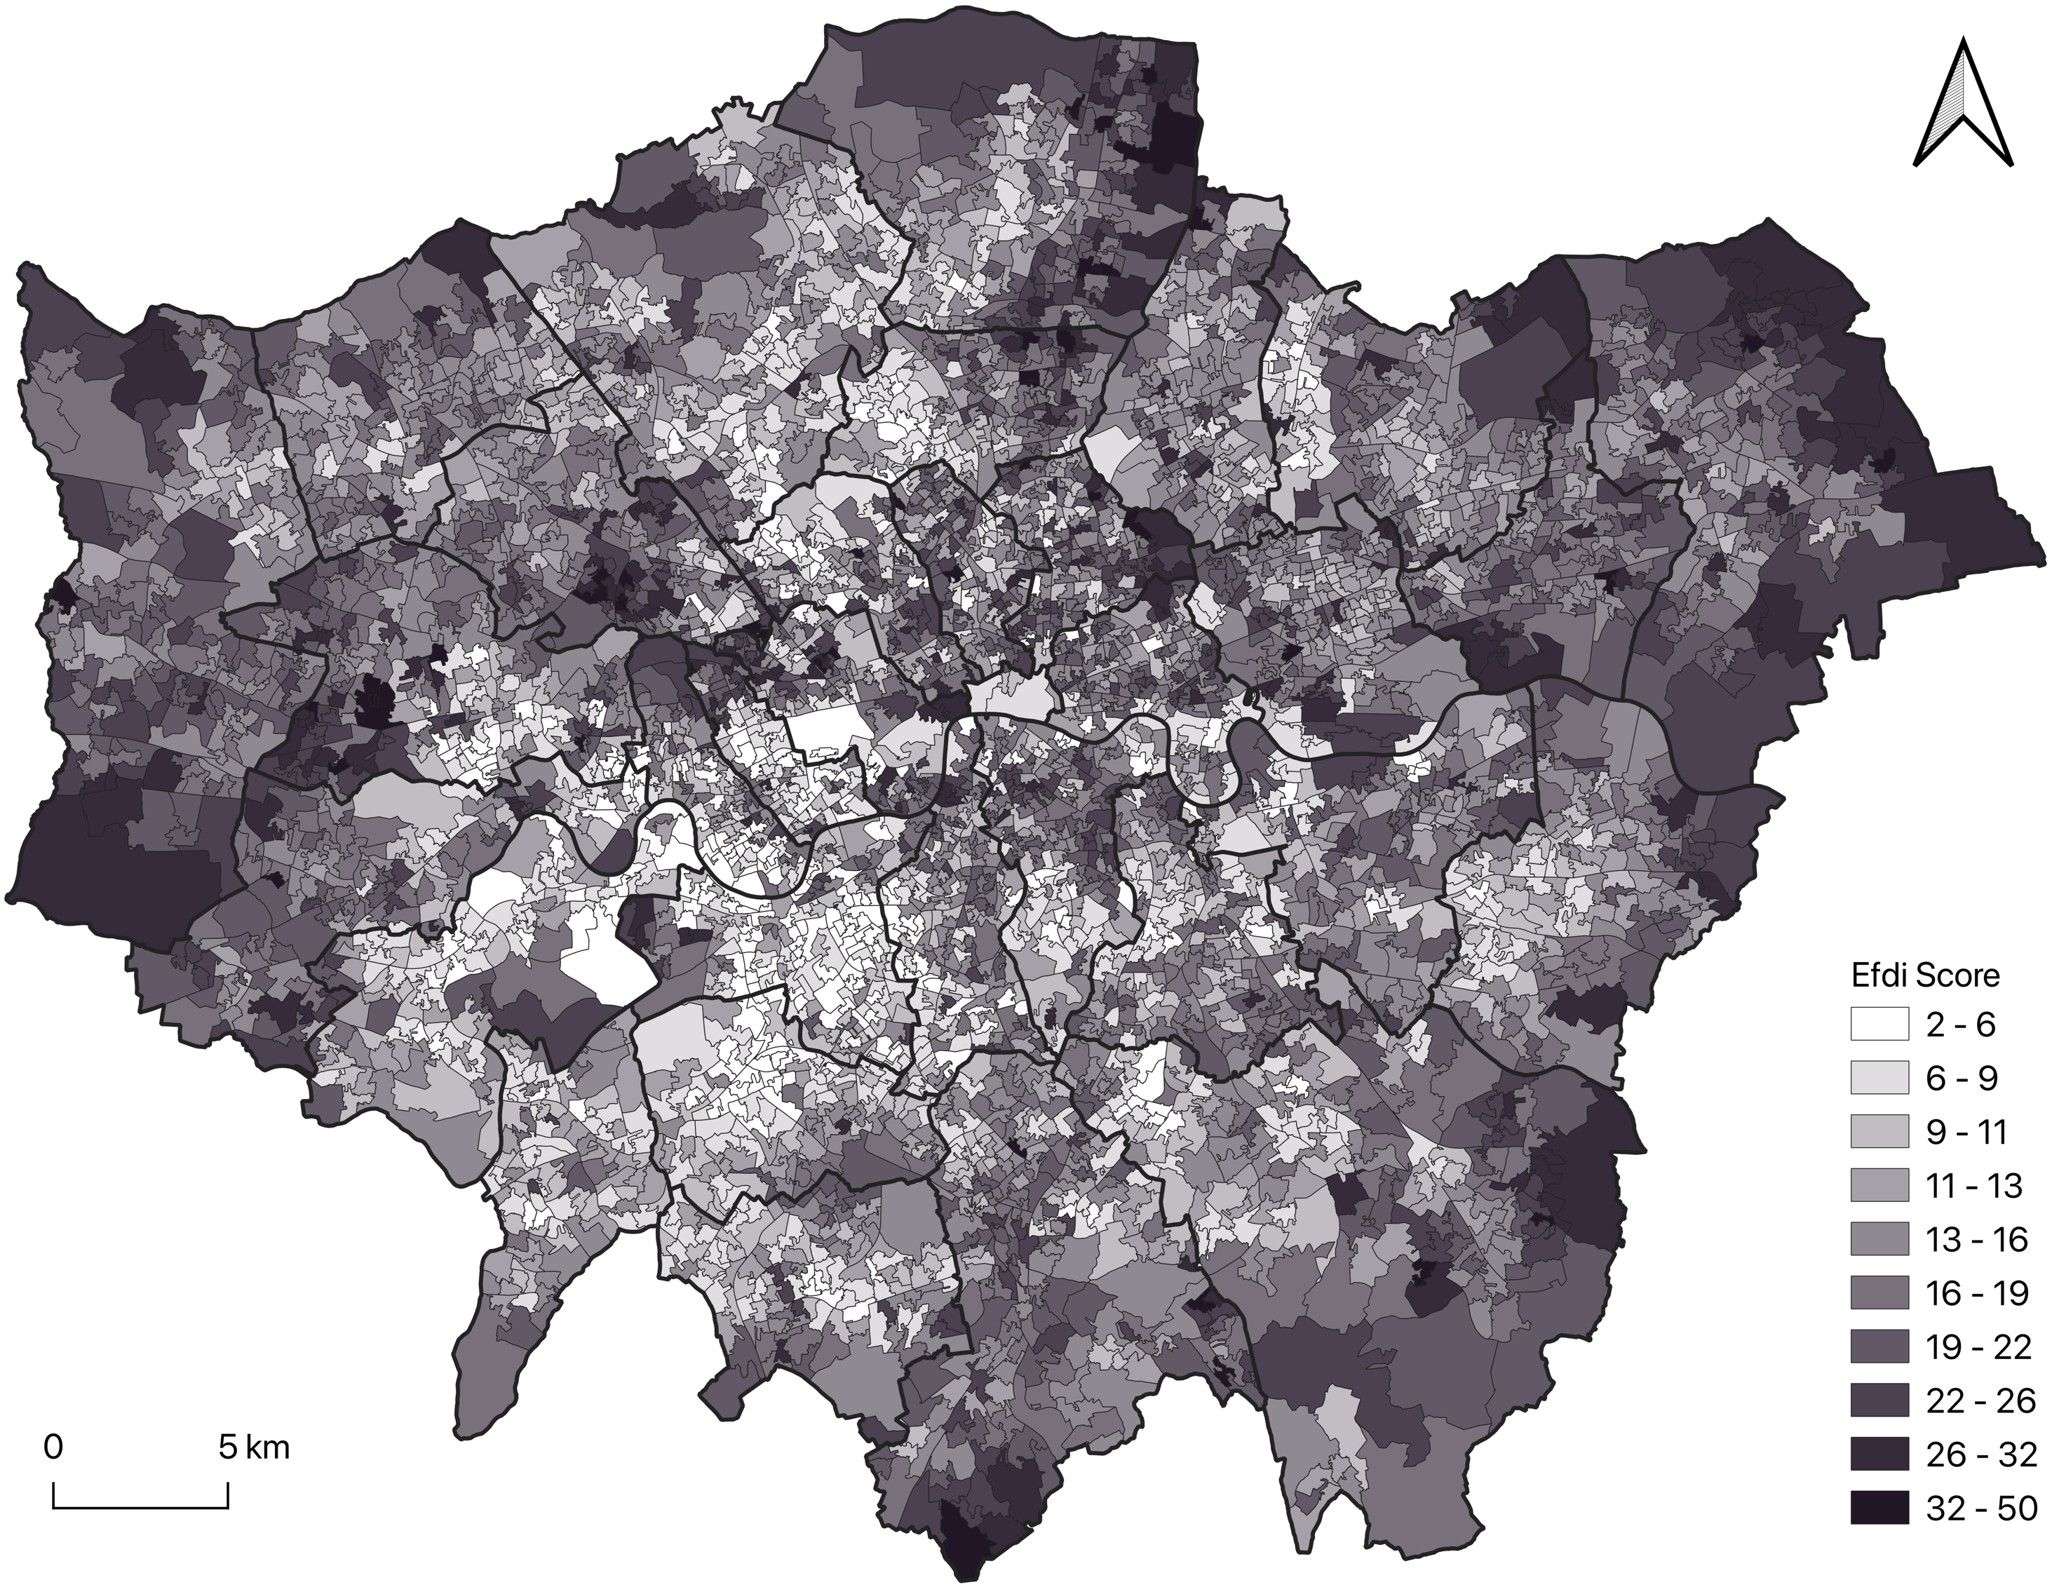
Independent & Dependent Variables
Independent variables：
Land Use proportion in London
Dependent variable：
E-food desert index (EFDI) in London
Community buildings
Leisure and recreational buildings
Defence total
Industry
Offices
Retail
Storage and warehousing
Minerals and landfill total
Institutional and communal accommodations
Residential
Transport and utilities total
Unknown developed use total
X
Y
Spatial Data Source: CDRC

Slide 9
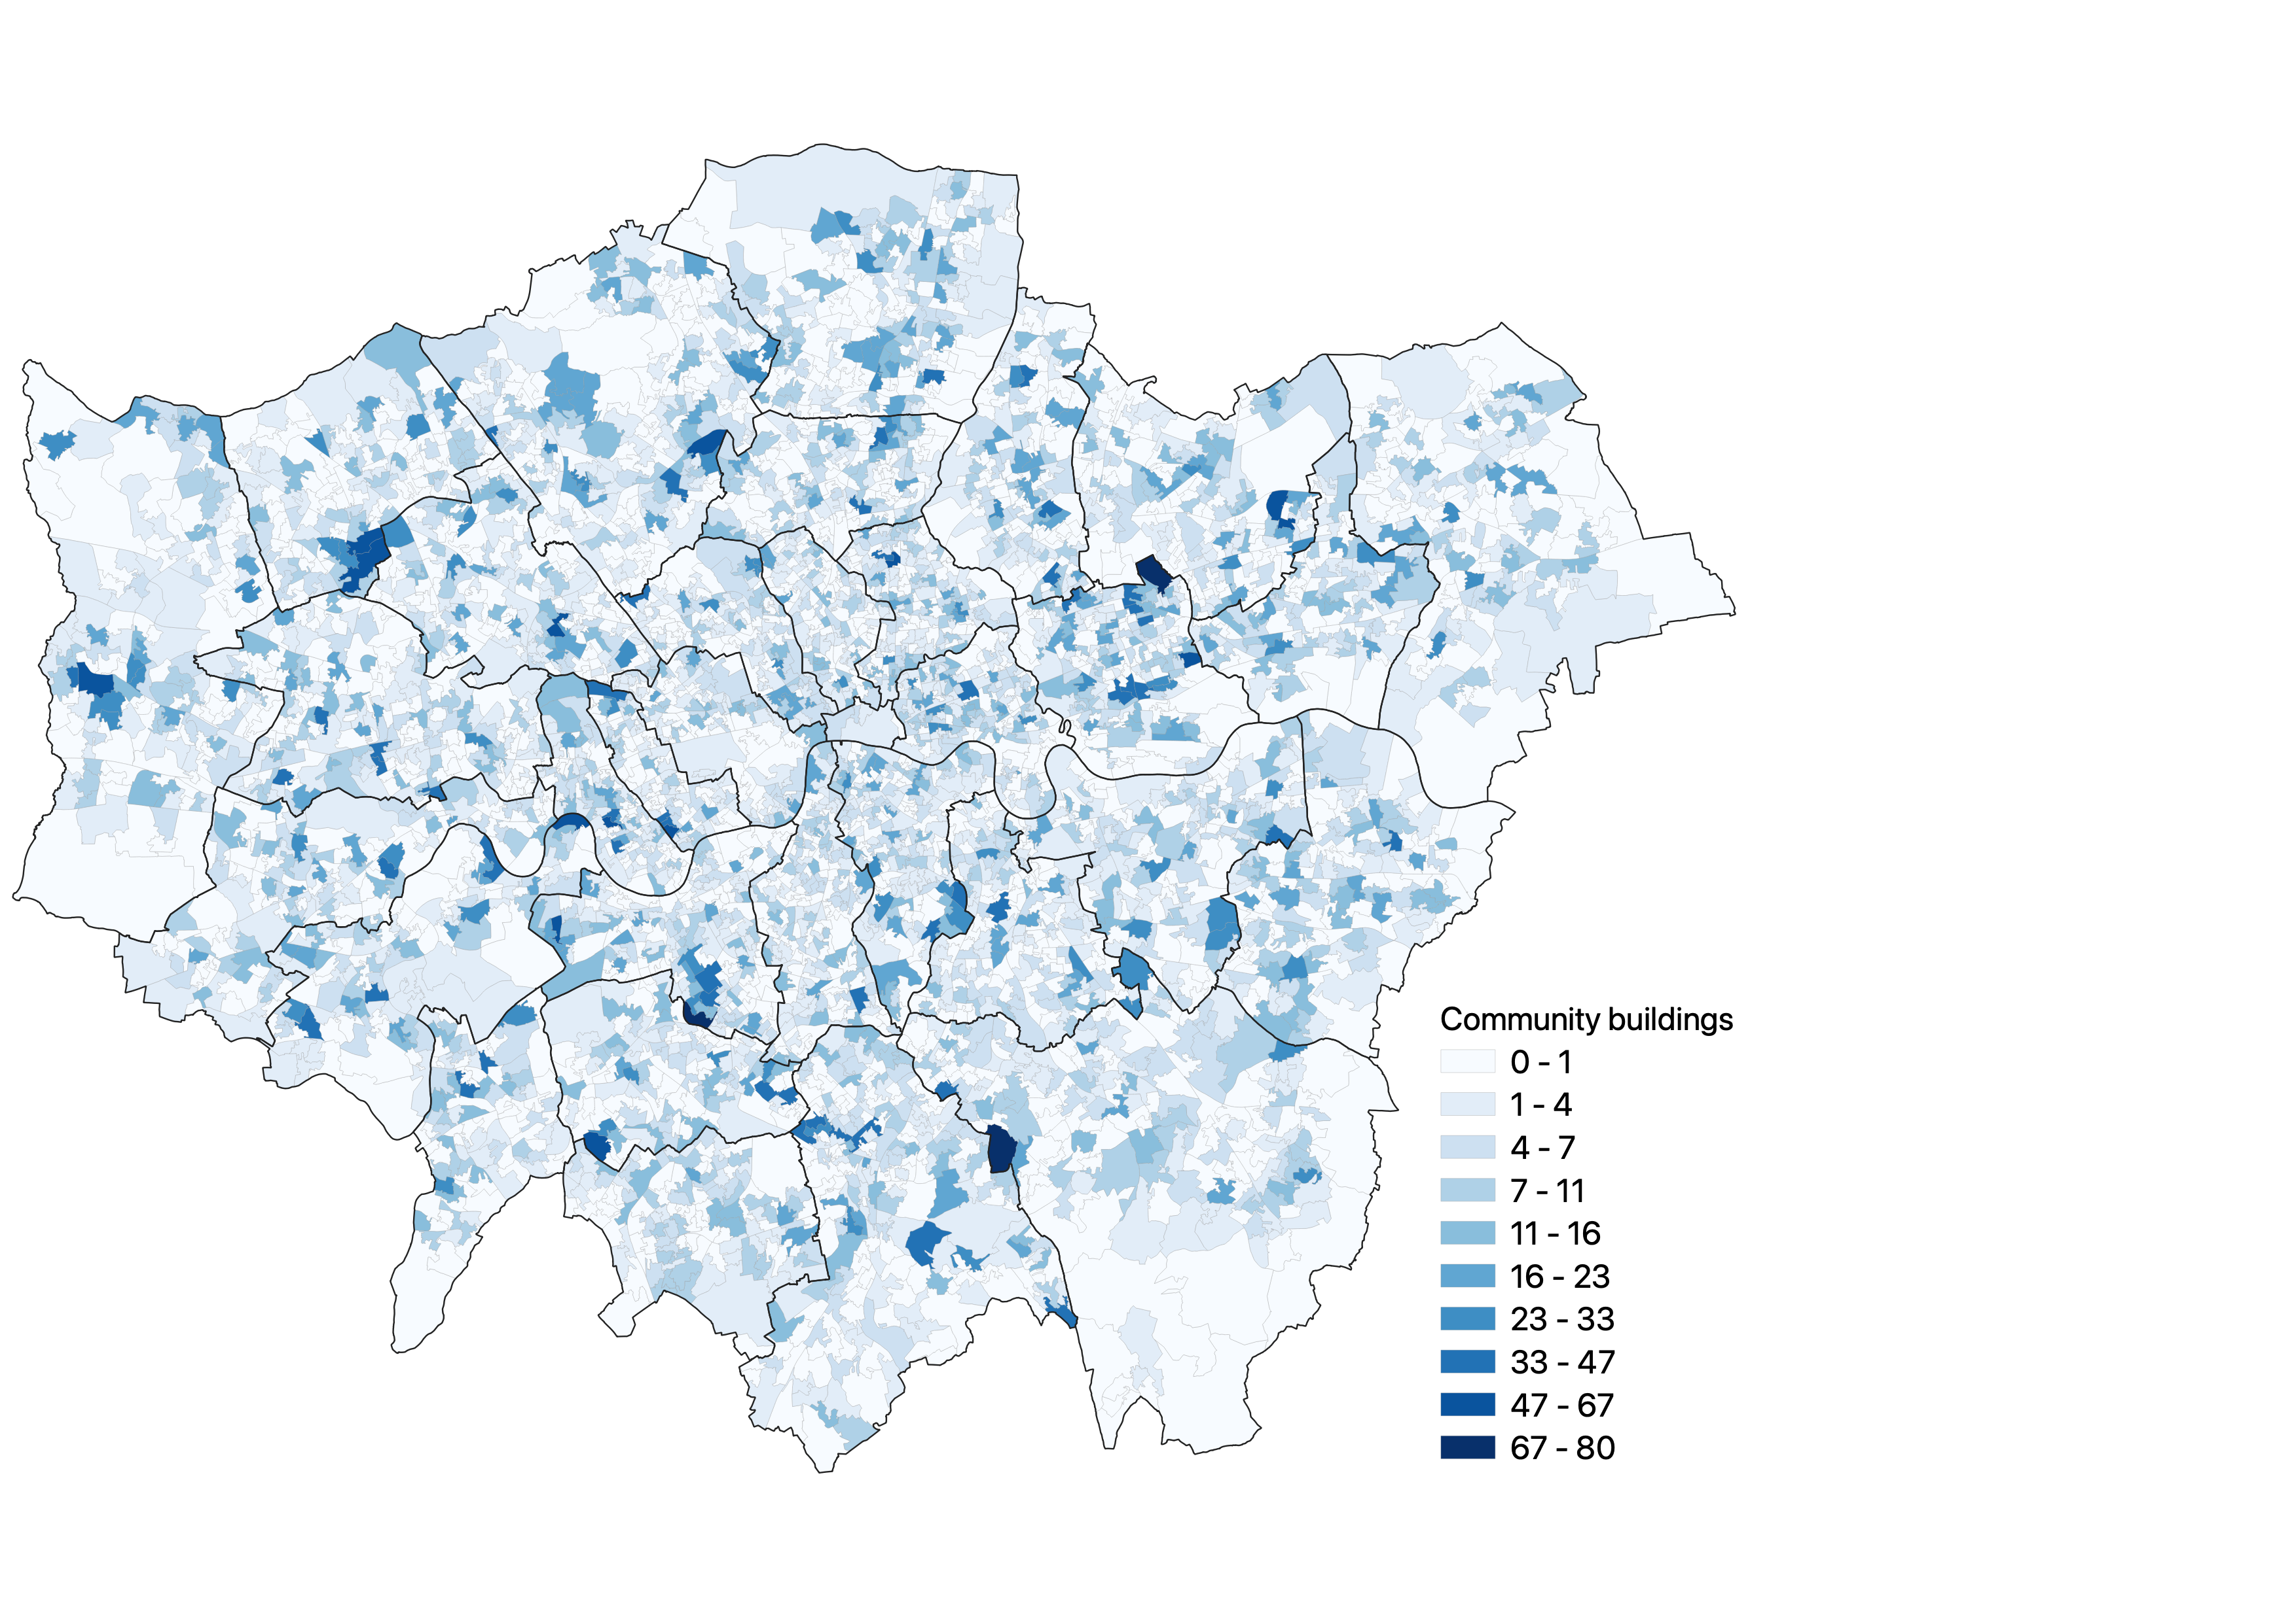
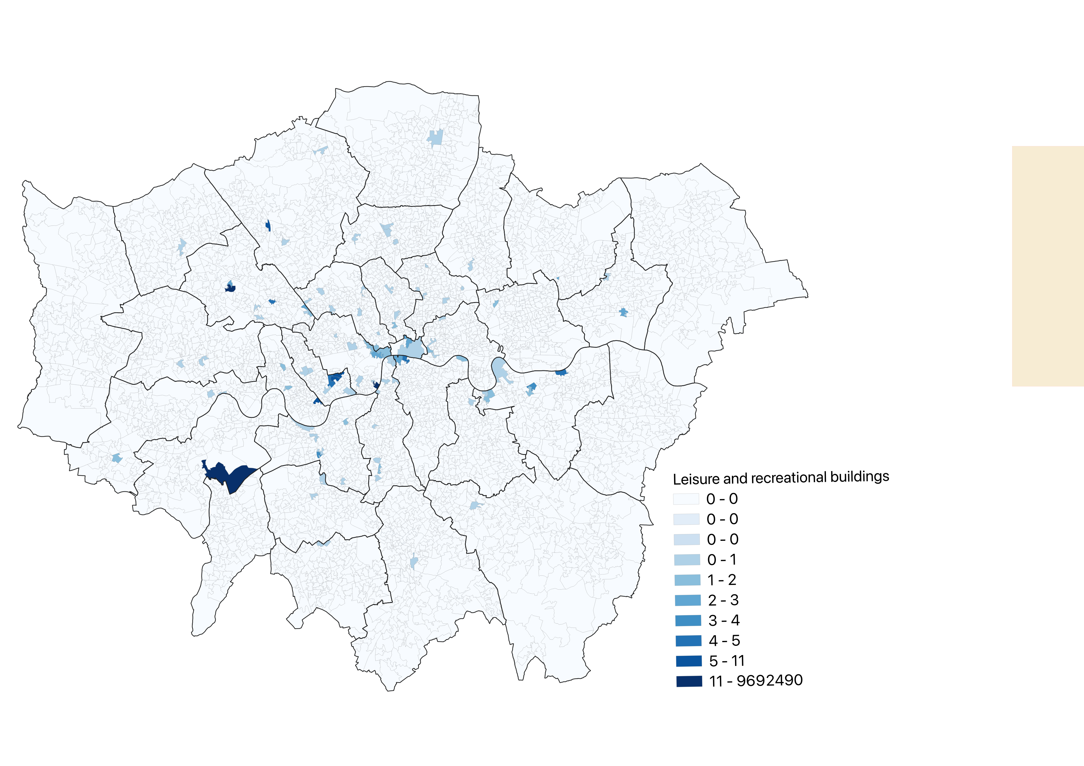
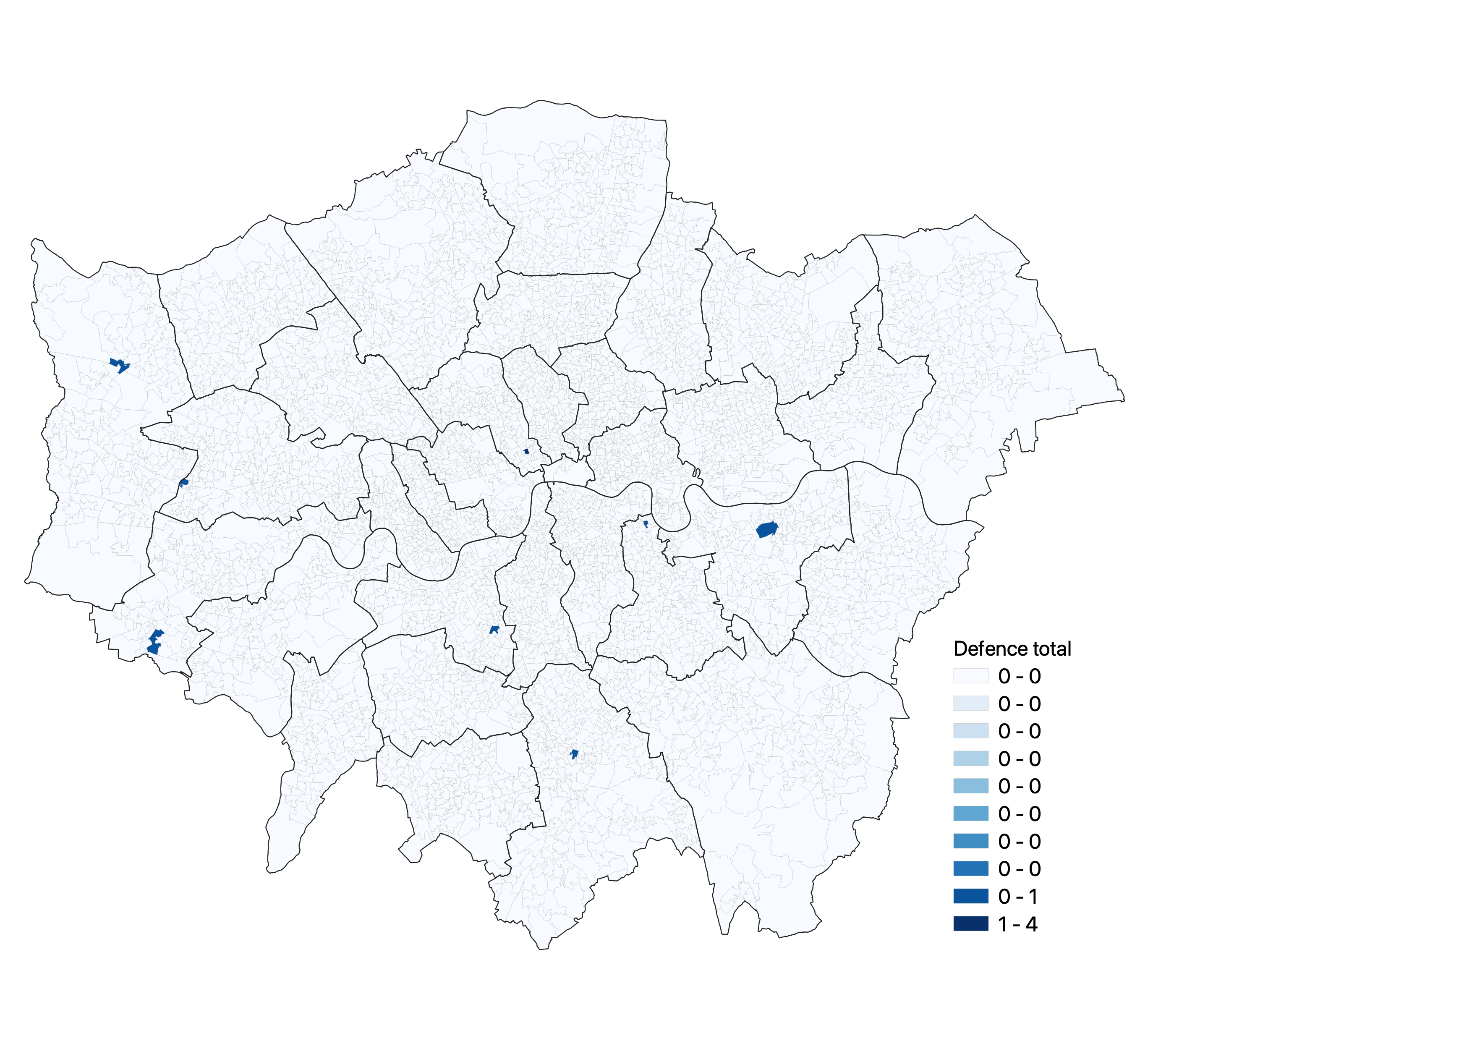
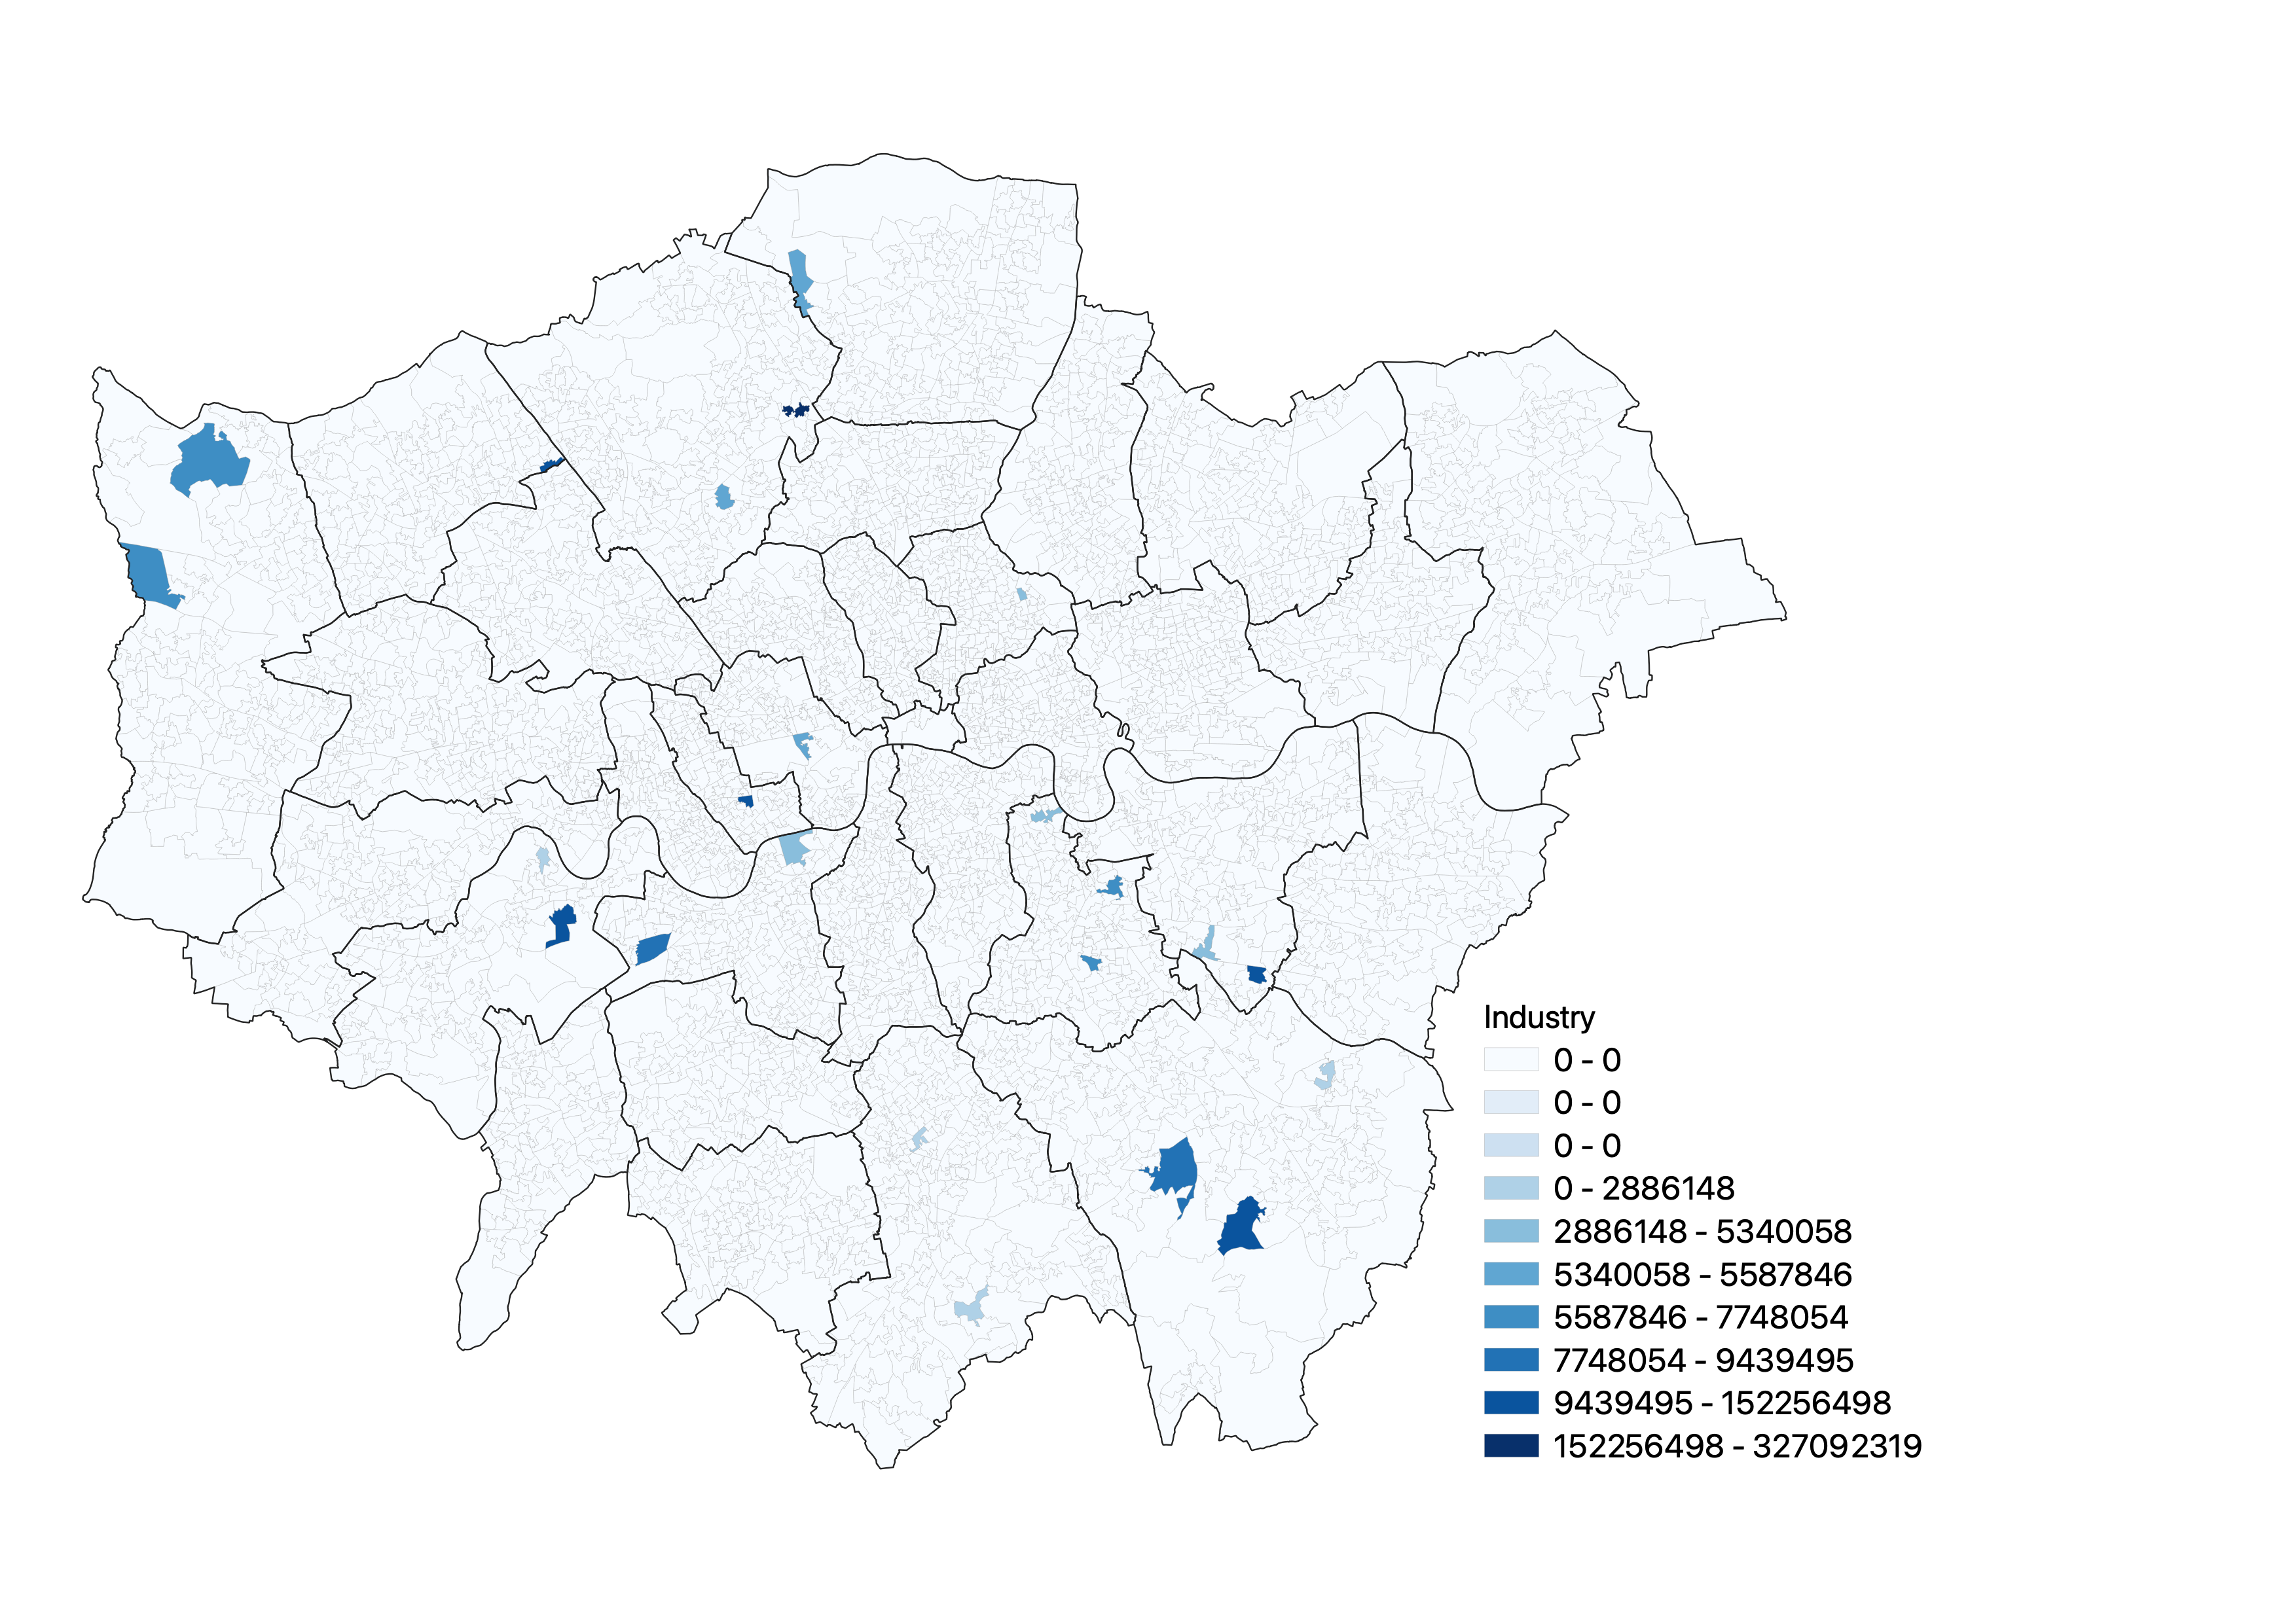
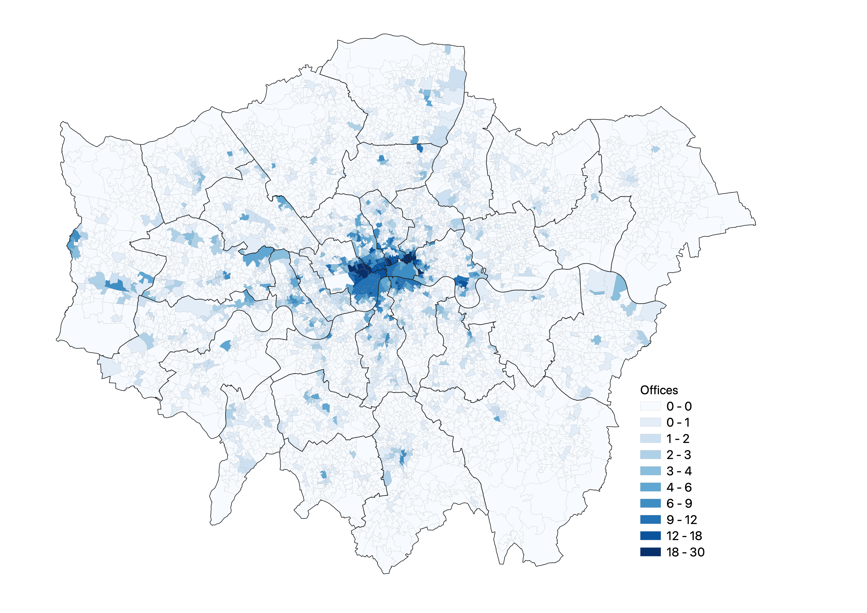
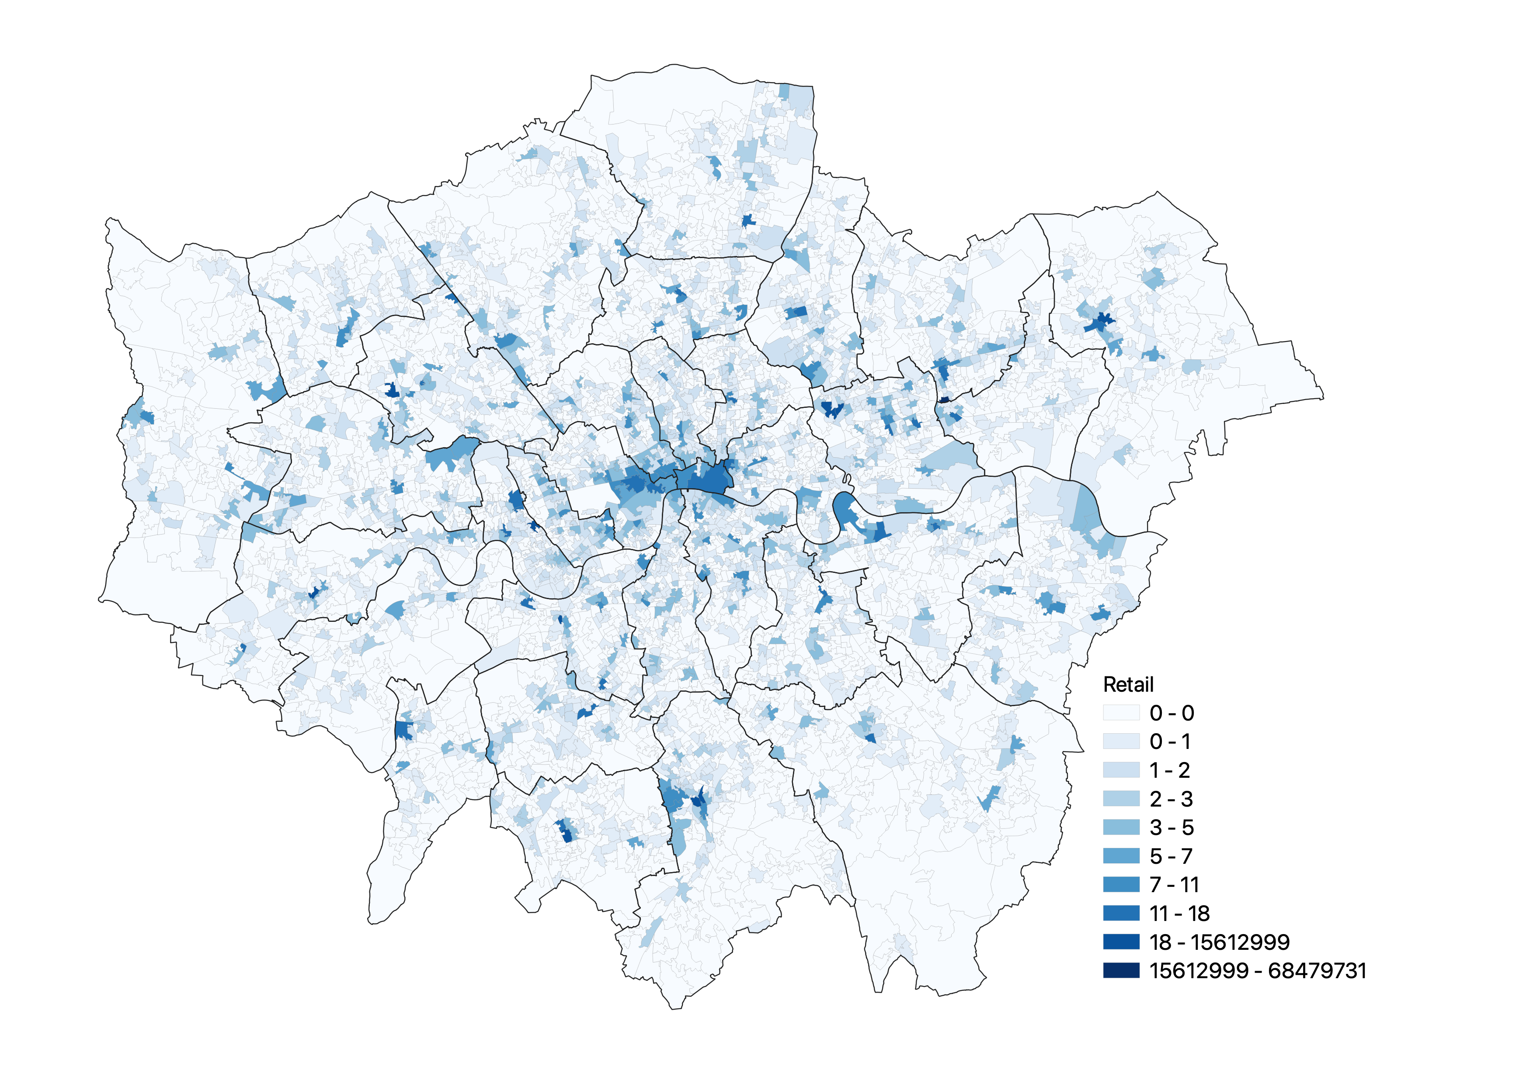
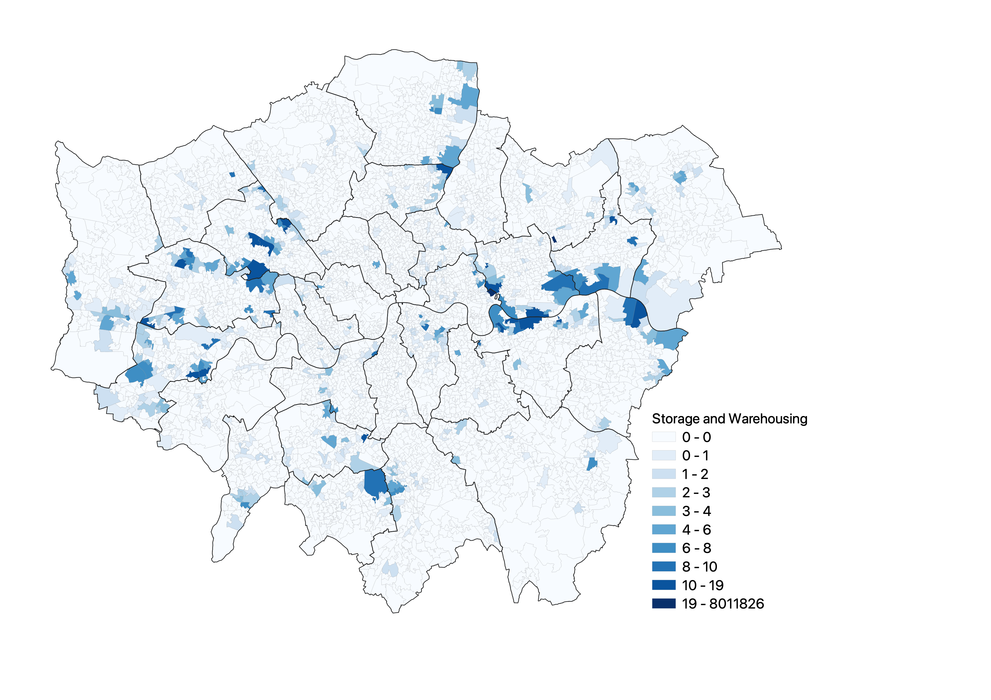
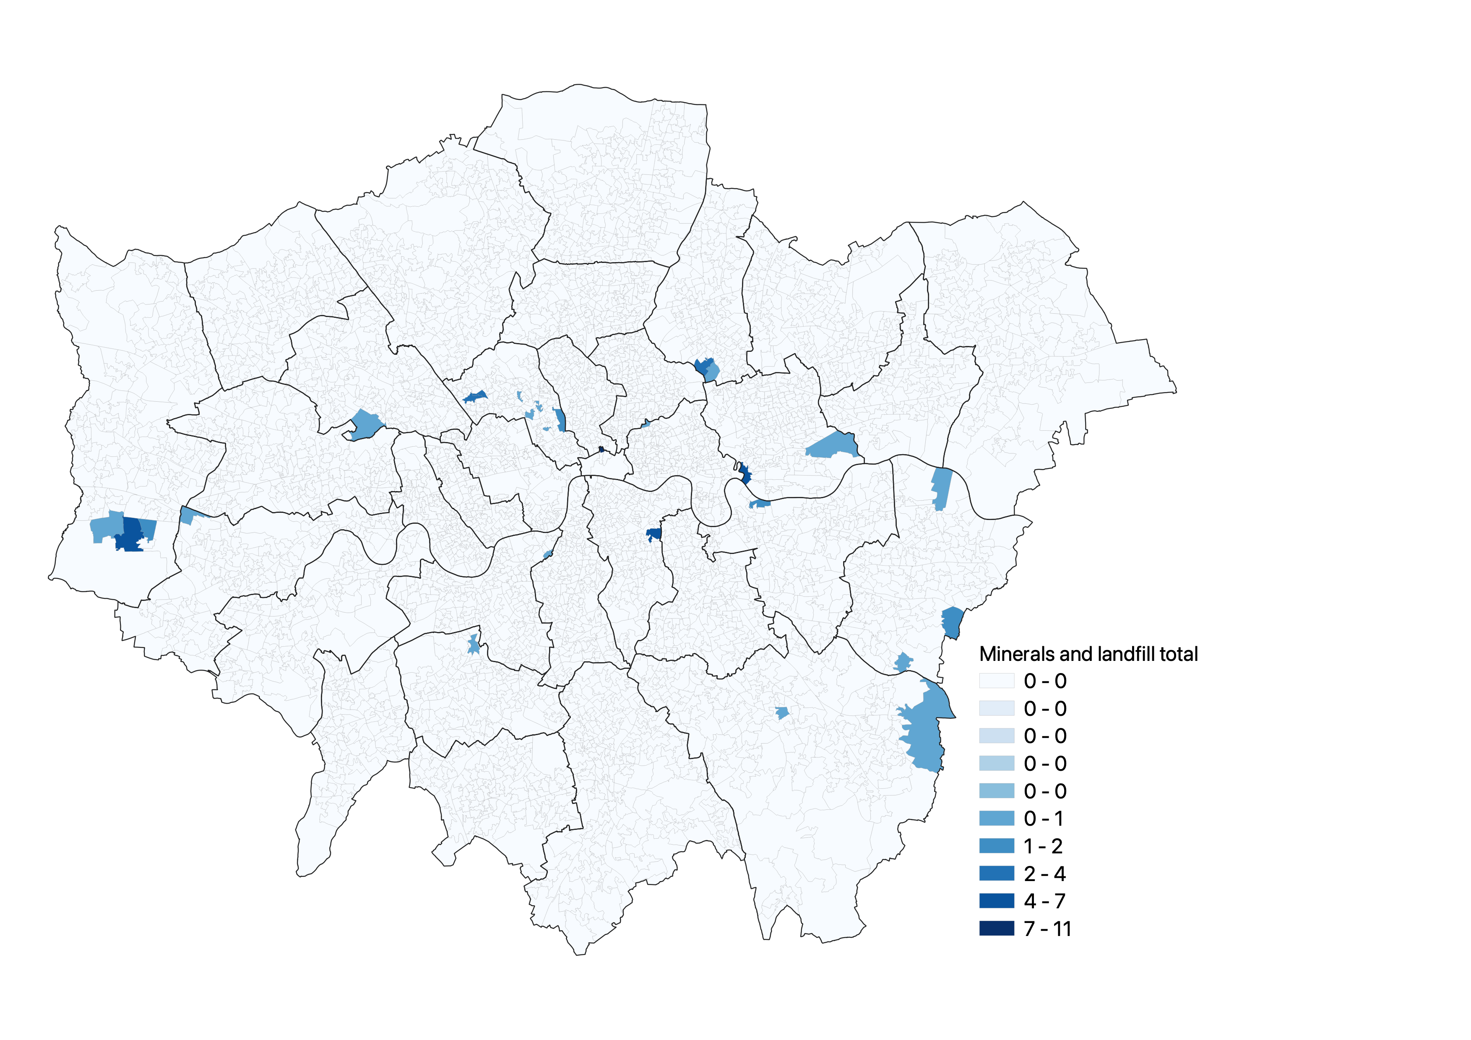
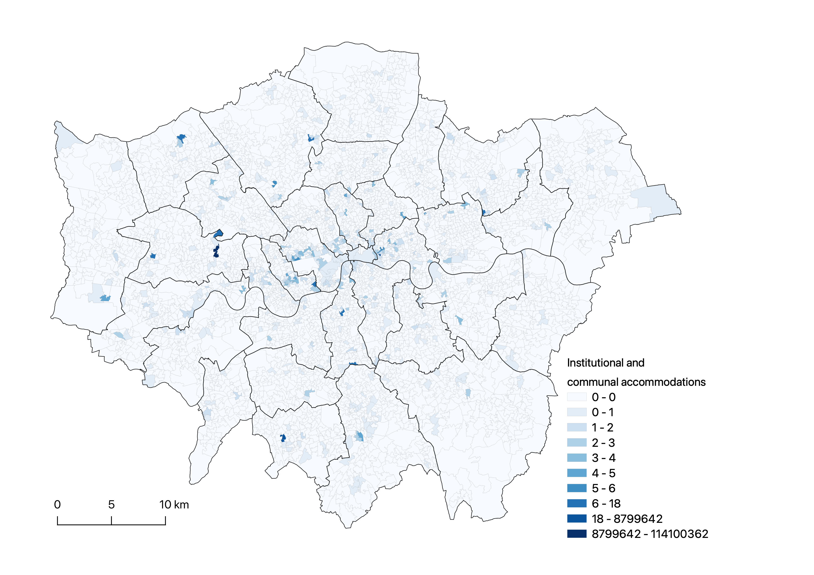
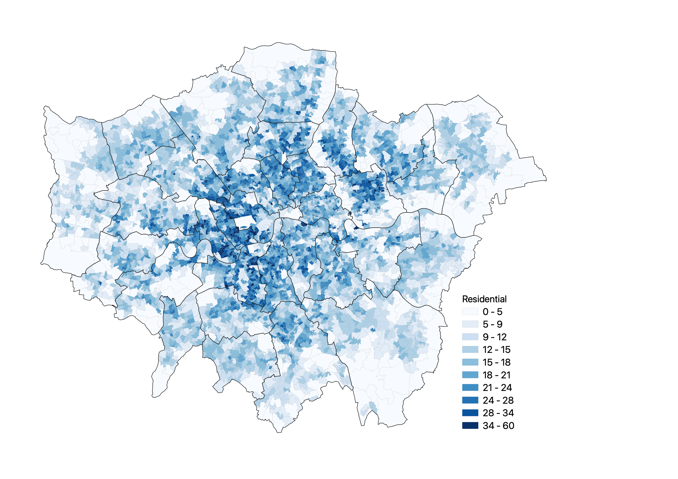
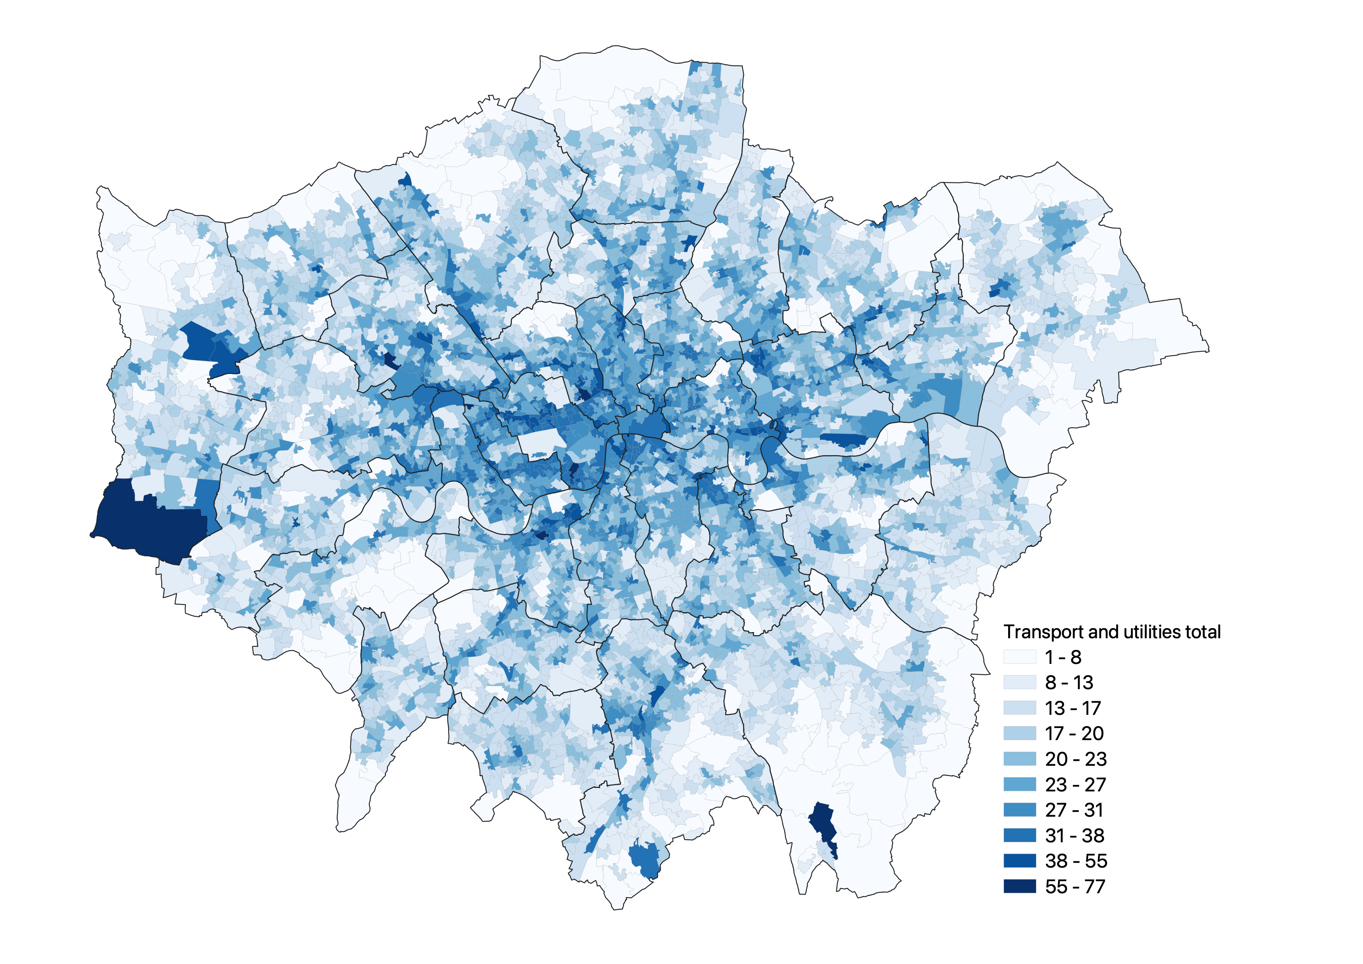
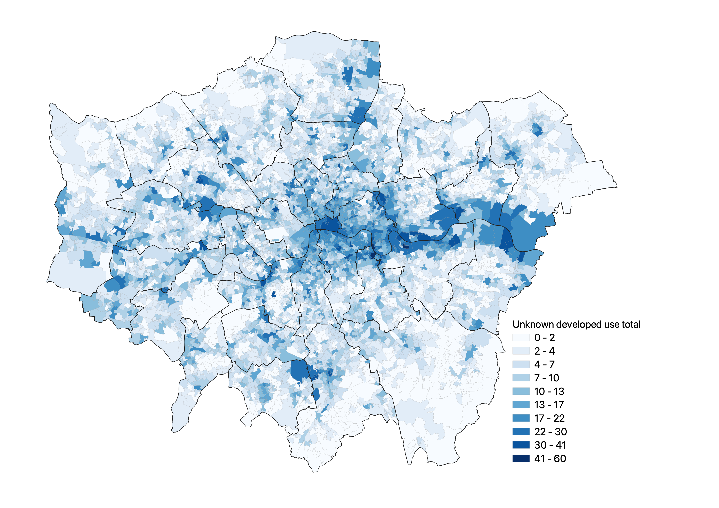
Community buildings
Leisure and recreational buildings
E-food desert index (EFDI) in London
Natural Breaks - 10 levels
Industry
Defence total
Offices
Retail
Storage and warehousing
Minerals and landfill total
Institutional and communal
accommodations
Residential
Transport and utilities total
Unknown developed use total

Slide 10



Data Source
E-food desert index in London
E-food Desert Index. (2020) Consumer Data Research Centre. Available at: https://www.gov.uk/government/statistics/land-use-in-england-2022/land-use-statistics-england-2022
Land use data in London
Landuse statistics: England. (2022) gov.uk. Available at: https://www.gov.uk/government/statistics/land-use-in-england-2022/land-use-statistics-england-2022
Lower Layer Super Output Areas (LSOA) spatial data in London
Lower Layer Super Output Areas (Dec 2021) Boundaries Full Extent (BFE) EW. (2022) Office for National Statistics. Available at: https://geoportal.statistics.gov.uk/datasets/ons::lower-layer-super-output-areas-dec-2021-boundaries-full-extent-bfe-ew/explore?location=51.486356%2C0.199883%2C13.57

Slide 11

2. Exploring Data
Descriptive statistics
Summary of key fields
To What Extant Does Land Use Impact on E-food Desert Index in London?

Slide 12
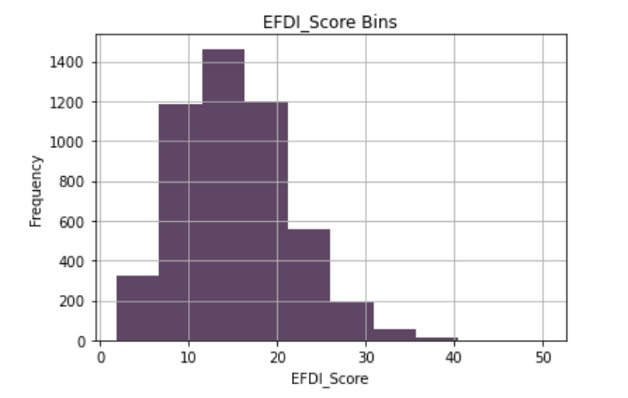
Descriptive statistics
Frequency distribution of independent variables（Y）

Slide 13
Descriptive statistics
Frequency distribution of independent variables（Y）

Slide 14
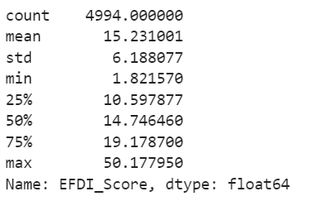
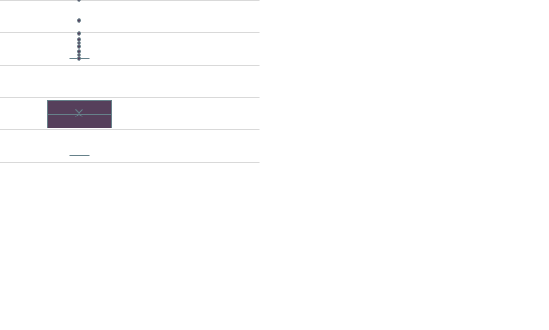
Descriptive statistics
Measures of Central Tendency - Dependent variable（Y）
75%
median
25%

Slide 15

Descriptive statistics
Frequency distribution of x-Finding sparse classes of data
Sparse classes of data often present problems when building models.
Sparse
classes of data

Slide 16
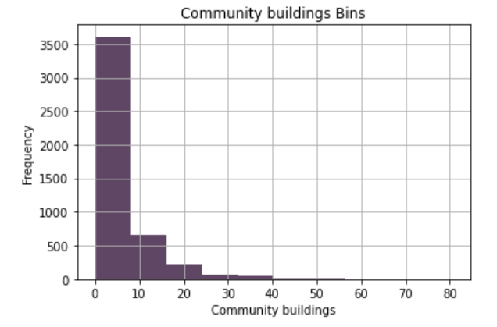
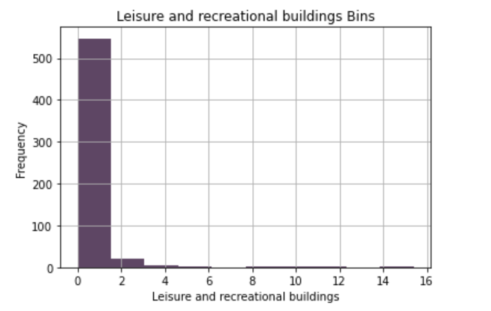
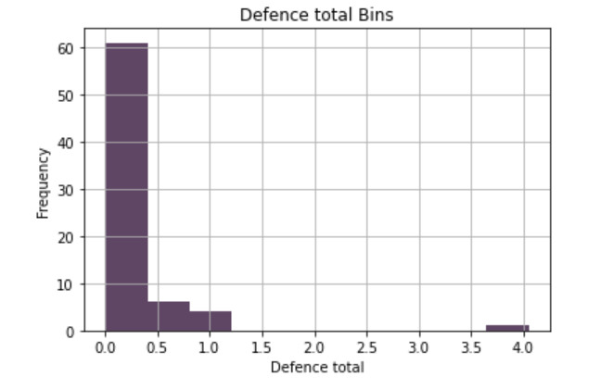
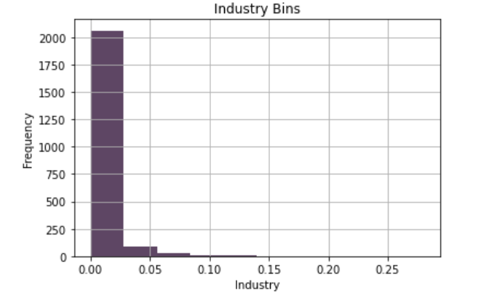
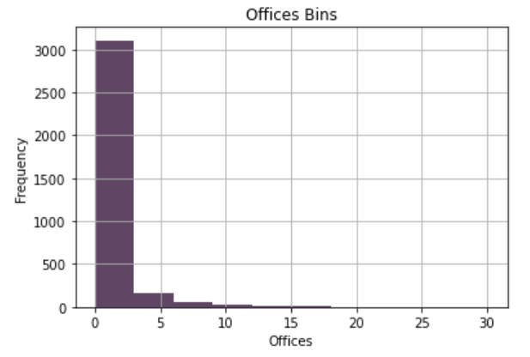
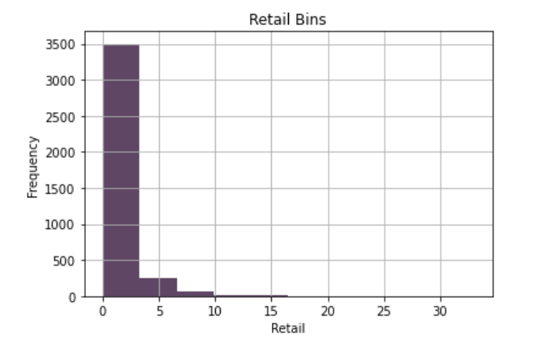
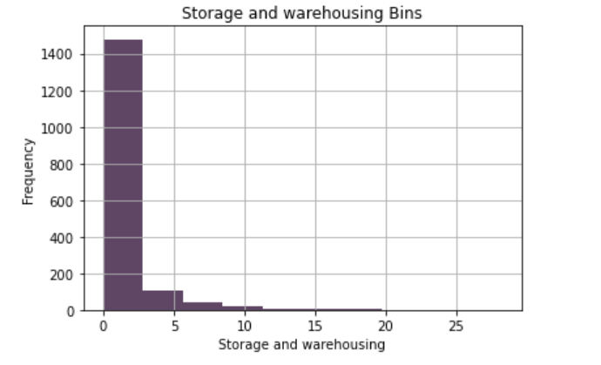
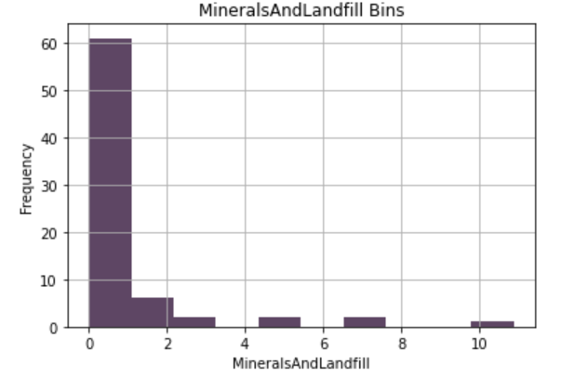
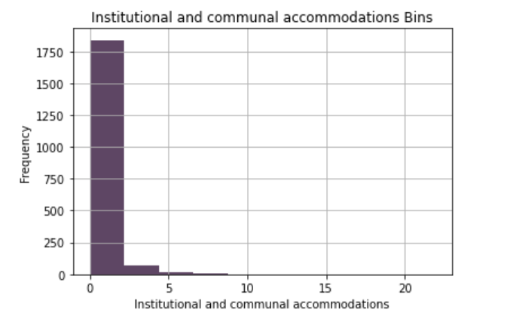
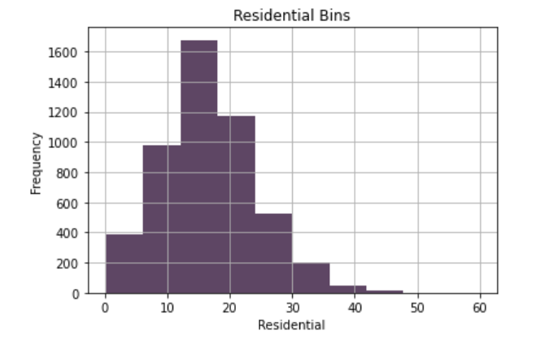
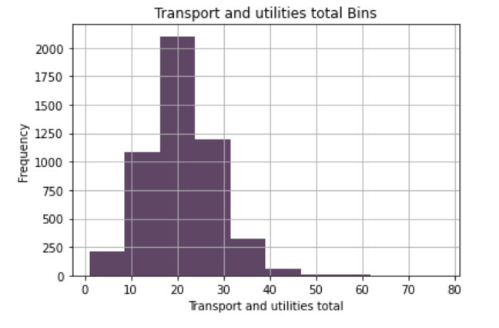
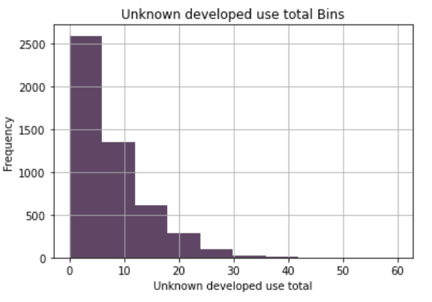
Descriptive statistics
Frequency distribution of x-Analysis of data distribution by histogram

Slide 17
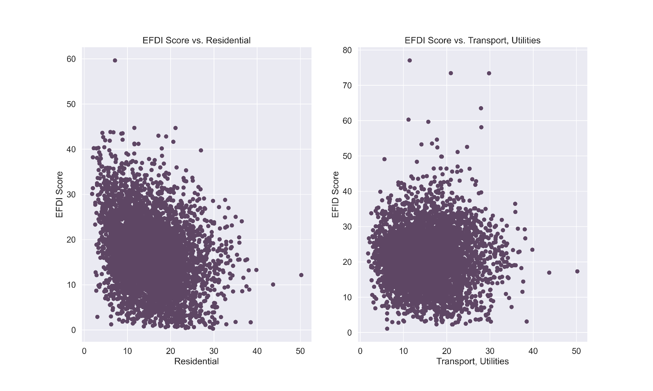
Descriptive statistics
Predicting the potential relationship between the independent and dependent variables.
outlier
outlier

Slide 18
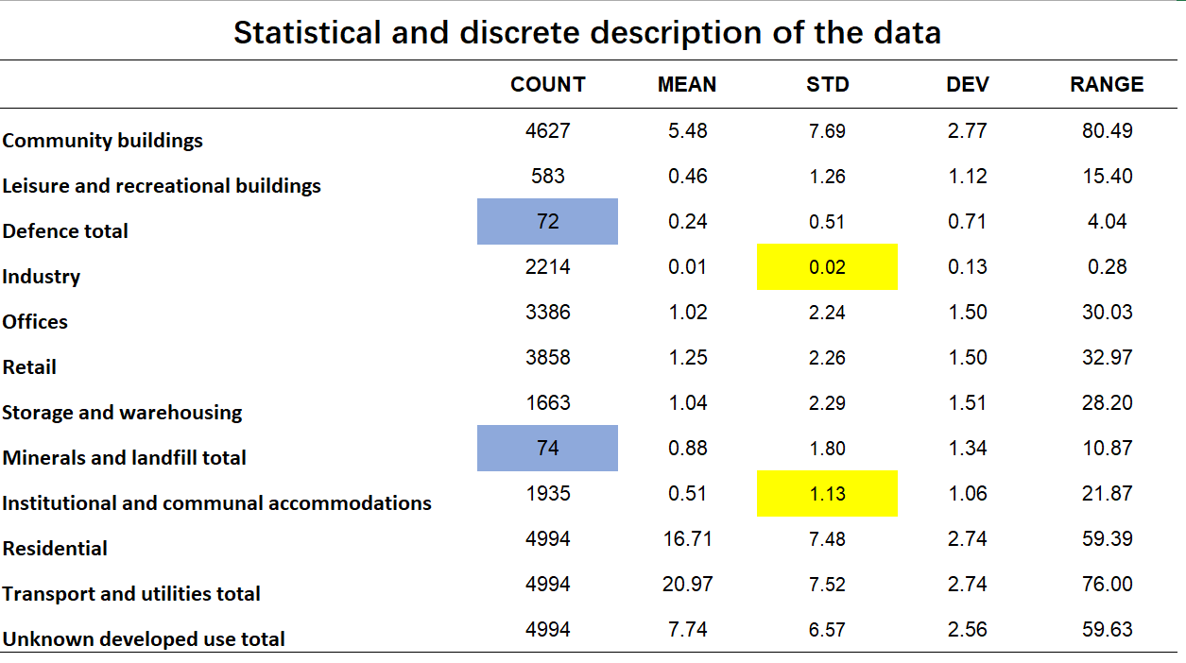
Descriptive statistics
Measures of Central Tendency of x-Statistical dispersion of the data

Slide 19
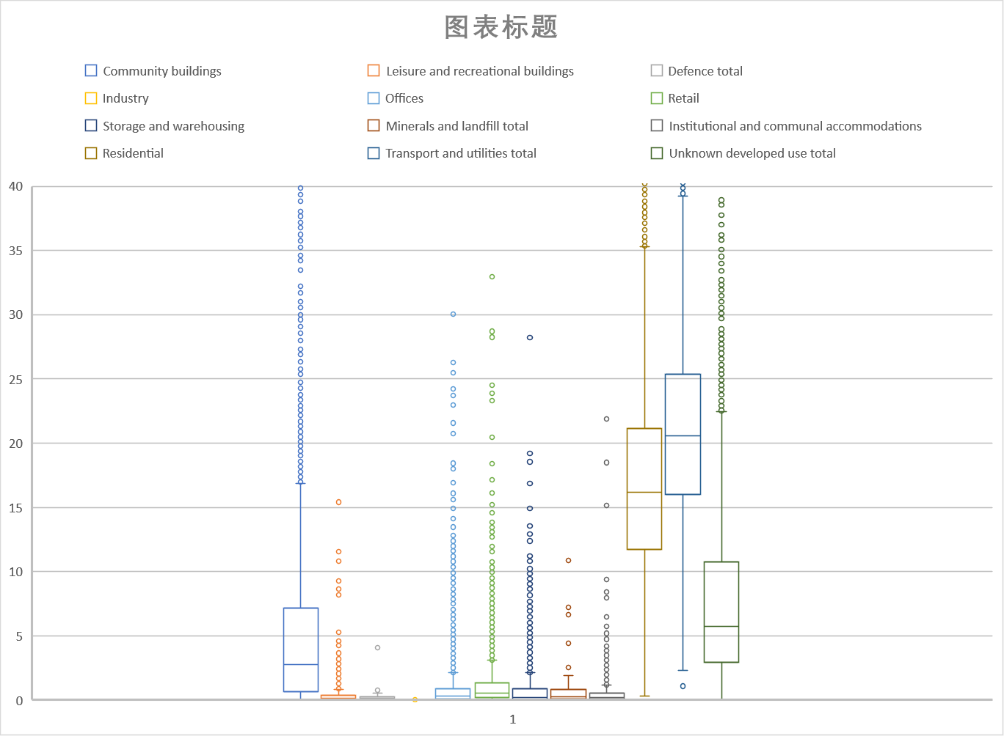
Descriptive statistics
Measures of Central Tendency of x-Judging the fluctuation by Box-plot

Slide 20
Summary of key fields
Some fields lack sufficient valid data. Some data values has serious outliers and needs to be removed.
(Defence, Minerals and landfill)
The data values in most fields are small and have a low level of dispersion.
Some fields have a trend similar to the normal distribution, while other fields have centralized data distribution.
(Residential, Transport and utilities)
(Industry, Institutional and communal accommodations)
These fields need to be focused on and modelled for further analysis of their data characteristics.

Slide 21
3. Modelling Analysis
Variable selection
Build and fit a linear model
Interpret the model
To What Extant Does Land Use Impact on E-food Desert Index in London?

Slide 22
Building Model Process
Identify the regression problem ✅
Explore data ✅
Variable selection
Build and fit a linear model
Interpret the model

Slide 23
Variable Selection
Correlation Analysis
Lasso Regression
Inflation Factors (VIF)

Slide 24
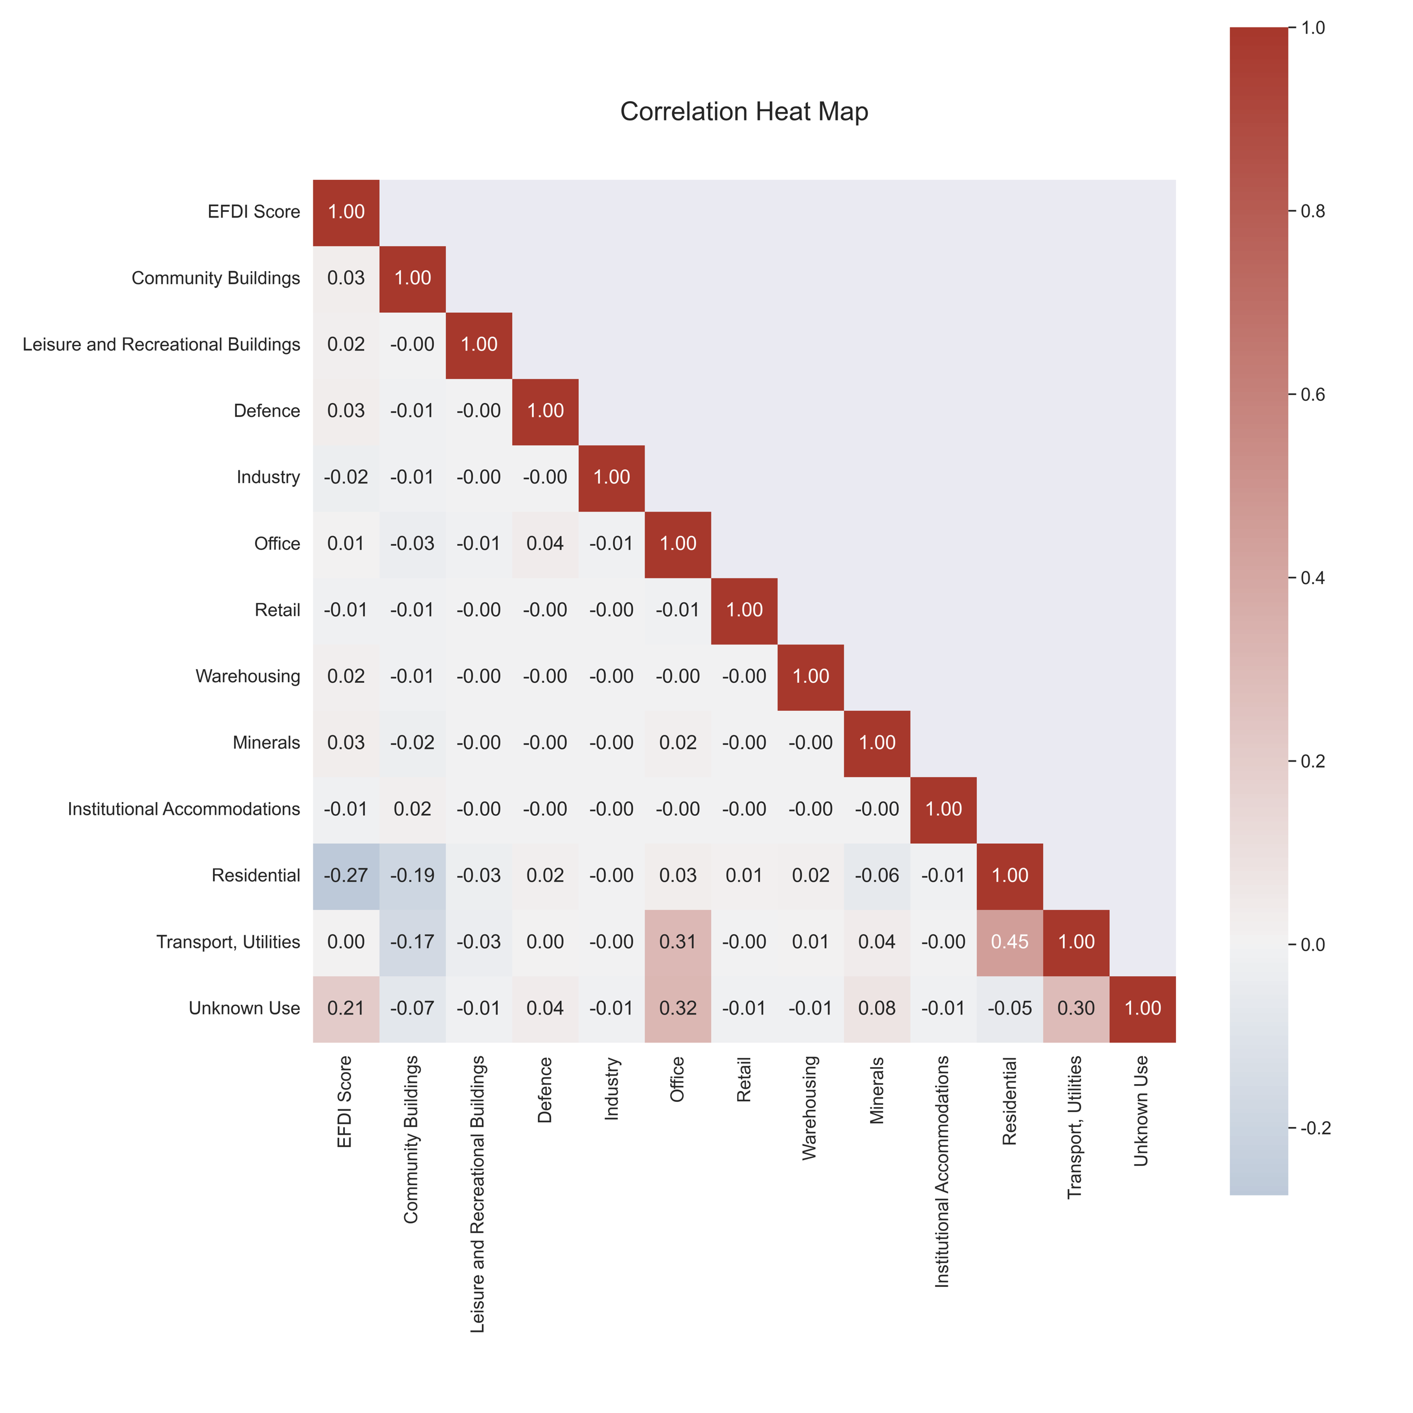
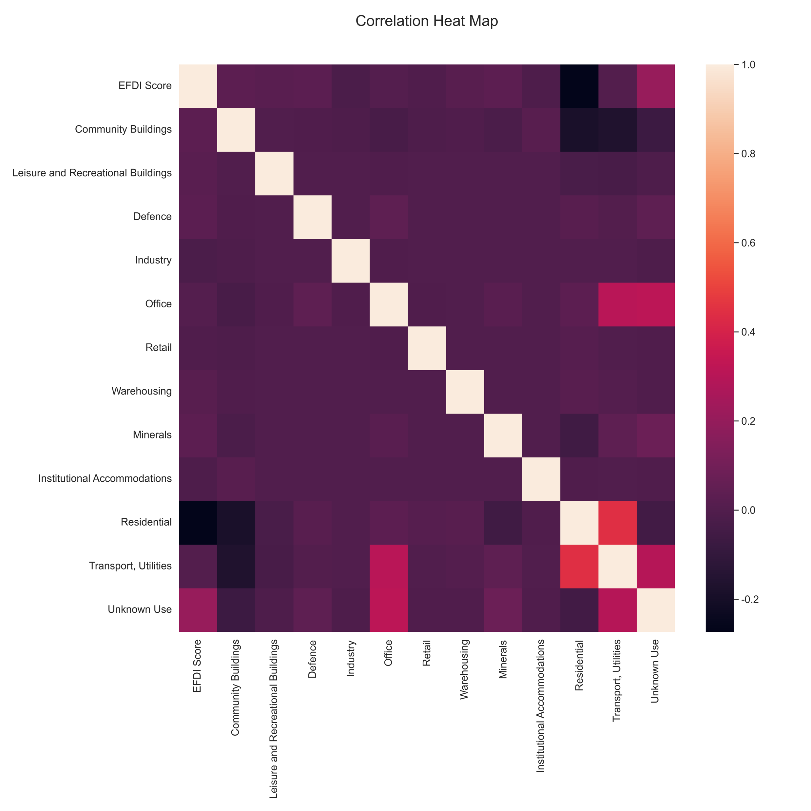
Variable Selection
Correlation Analysis

Slide 25
Variable Selection
Correlation Analysis

Slide 26
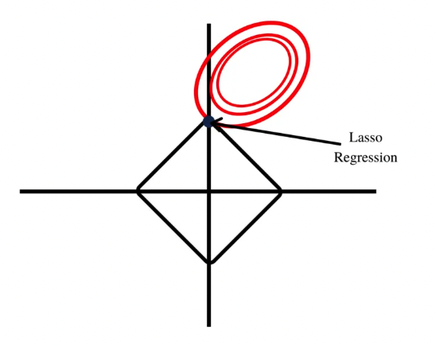
Variable Selection
Lasso Regression
LASSO, short for Least Absolute Shrinkage and Selection Operator, is a statistical formula whose main purpose is the feature selection and regularization of data models. The method was first introduced in 1996 by Statistics Professor Robert Tibshirani. LASSO introduces parameters to the sum of a model, giving it an upper bound that acts as a constraint for the sum to include absolute parameters within an allowable range.
Lasso (2022) Corporate Finance Institute. Available at: https://corporatefinanceinstitute.com/resources/data-science/lasso/ (Accessed: December 12, 2022).

Slide 27
Variable Selection
Lasso Regression
Survived Variables:
Industry
Institutional And Communal Accommodation
Residential
Transport and Utilities

Slide 28
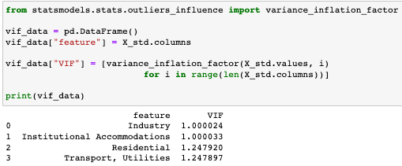
Variable Selection
Variance Inflation Factors (VIF)
Threshold = 5
No Multicollinearity

Slide 29
Build and Fit Model
Standardization
Model Building

Slide 30
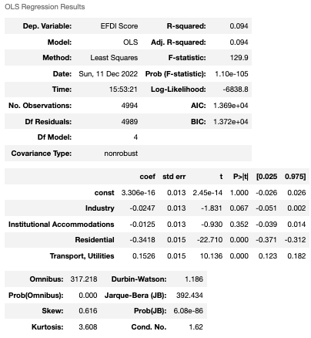
Build and Fit Model
Model Building
Ordinary Least Squares

Slide 31
Interpret the model
R^2, F-statistic
Test the Linear Regression’s Assumptions
Conclusion

Slide 32
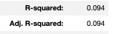
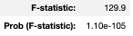
Build and Fit Model
R^2, F-statistic

Slide 33
Interpret the model
Test the Linear Regression’s Assumptions
Linearity
Independence
Normality
Equal Variance

Slide 34
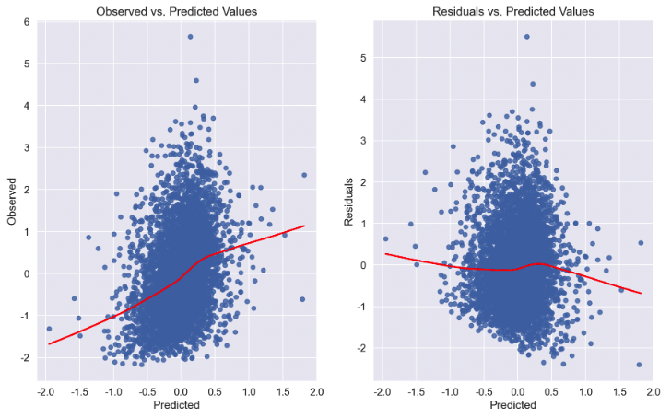
Interpret the model
Linearity

Slide 35
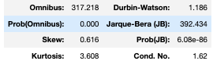
Interpret the model
Independence
Durbin-Waston Statistic

Slide 36
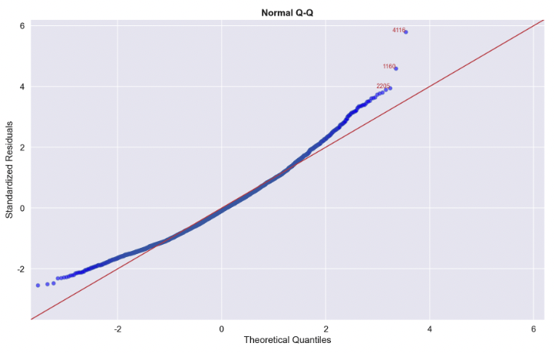
Interpret the model
Normality

Slide 37
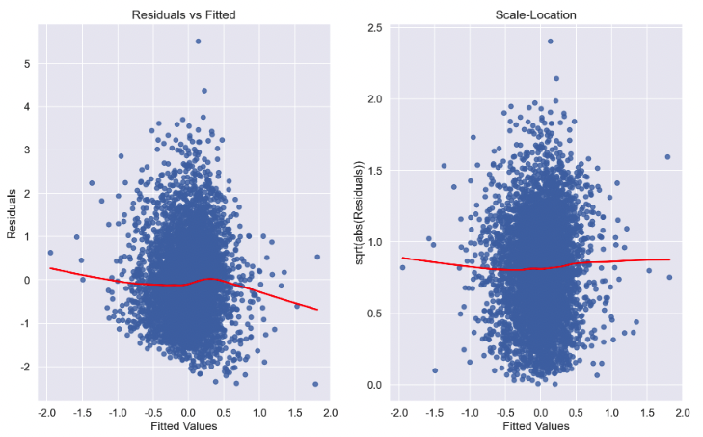
Interpret the model
Equal Variance

Slide 38
Interpret the model
Conclusion
There is no linear relationship between dependent and independent variables.

Slide 39
4. Discussion
Conclusion
Combined with literature
Limitation
Reference
To What Extant Does Land Use Impact on E-food Desert Index in London?

Slide 40
Conclusion
According to our analysis, the impact of Land use on e-food desertification in London is not significant.
However there are a number of other drawbacks and limitations to this study

Slide 41
Limitation
Different times of data collection
Different collection methods
Type of data itself
Model adoption
Other possible independent variables

Slide 42
Discussion
Newing et.al b (2022) shows that the availability and consumer acceptance of online groceries in the UK is growing rapidly but that the growth and availability of online groceries is exacerbating existing inequalities in rural and urban retail provision. And there has been a shift in online grocery preferences among newly crowned pneumonia consumers.
London - Centre of England（city）
Wrigley（2022）Retailers have driven London's regeneration and although the impact of retail sites on food desertification was not significant in this study, it is still a factor that could be studied in other city’s e-food desertification especially like Hull, Bristol and Tameside.
Newing, A., Hood, N., Videira, F.& Aewis, J. (2022) ‘Sorry we do not deliver to your area’: geographical inequalities in online groceries provision, The International Review of Retail, Distribution and Consumer Research, 32:1, 80-99, DOI: 10.1080/09593969.2021.2017321
Wrigley，N(2002)'Food Deserts' in British Cities: Policy Context and Research Priorities.Urban Studies , October 2002, Vol. 39, No. 11, pp. 2029-2040 .URL: https://www.jstor.org/stable/43196800

Slide 43
Tasks Arrangement
Youtian Peng
Identify the regression problem
Explore data
Variable selection
Build and fit a linear model
Interpret the model
Yijing(Rose) Zhang
Background analysis
Data selection and source
Mapping analysis and visualisation
Slides general arrangement and design
Zhang Qin
Frequency distribution analysis
Measures of central tendency
Summary of key fields
Huayue(Rayne) Cheng
Analysis of data types and dependent variable distribution
Conclusion and limitation
Reference

Slide 44

Thank You
Group 3

